Slide 1
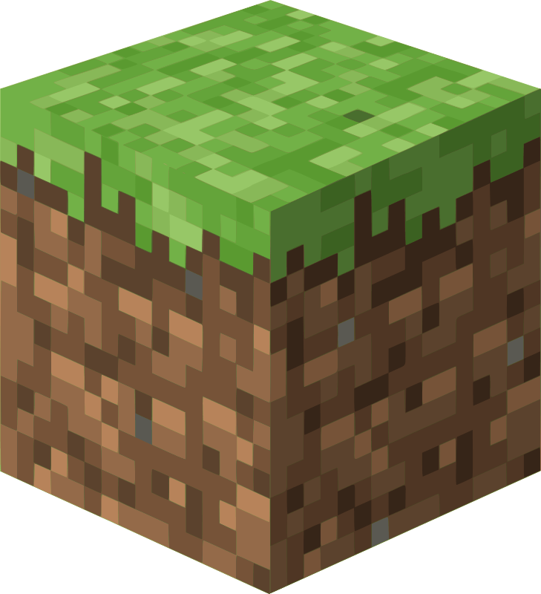
Minecraft World Generator AI
Using machine learning techniques to generate terrain.

Slide 2
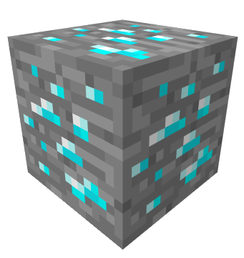
Where did the idea come from?
Minecraft has been applauded for its terrain generation for years. Traditionally, terrain was created in Minecraft using mathematical functions.
However, this approach suffers from not being able to create interesting structures on Earth created from erosion, such as arches and cliffs.
Coming up with a function that can describe these structures has evaded researchers and engineers in the field for years. We thought we might be able to use machine learning to fill this gap.

Slide 3
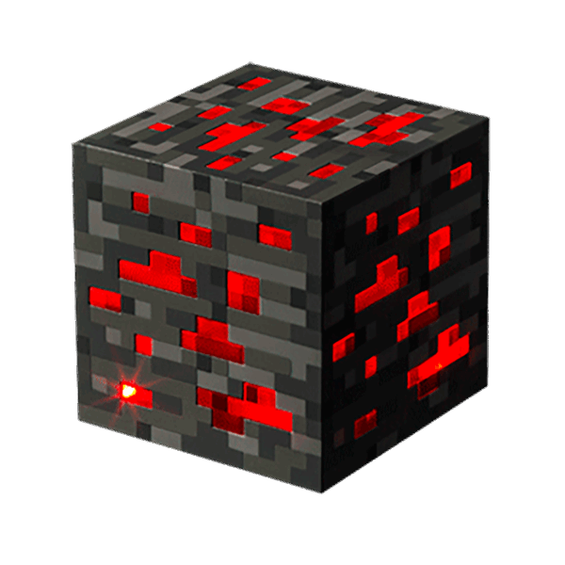
How did we approach the idea?
We wanted to automatically generate complex and exciting structures from real world data in order to empower artists, game creators, and researchers to innovate and streamline their content production.

Slide 4
Why are we passionate about it?
“I have been playing Minecraft since 2009, I love to build game technology and machine learning promises a new frontier on capabilities and experiences.”
- David Parker (team leader)

Slide 5
How does it work?
We trained a Generative Adversarial Network on LiDAR point cloud data taken from real geographical locations (White Canyon, Utah) to generate new examples of Earth surfaces.
We focused specifically on mountainous and canyon-like features for this model.

Slide 6
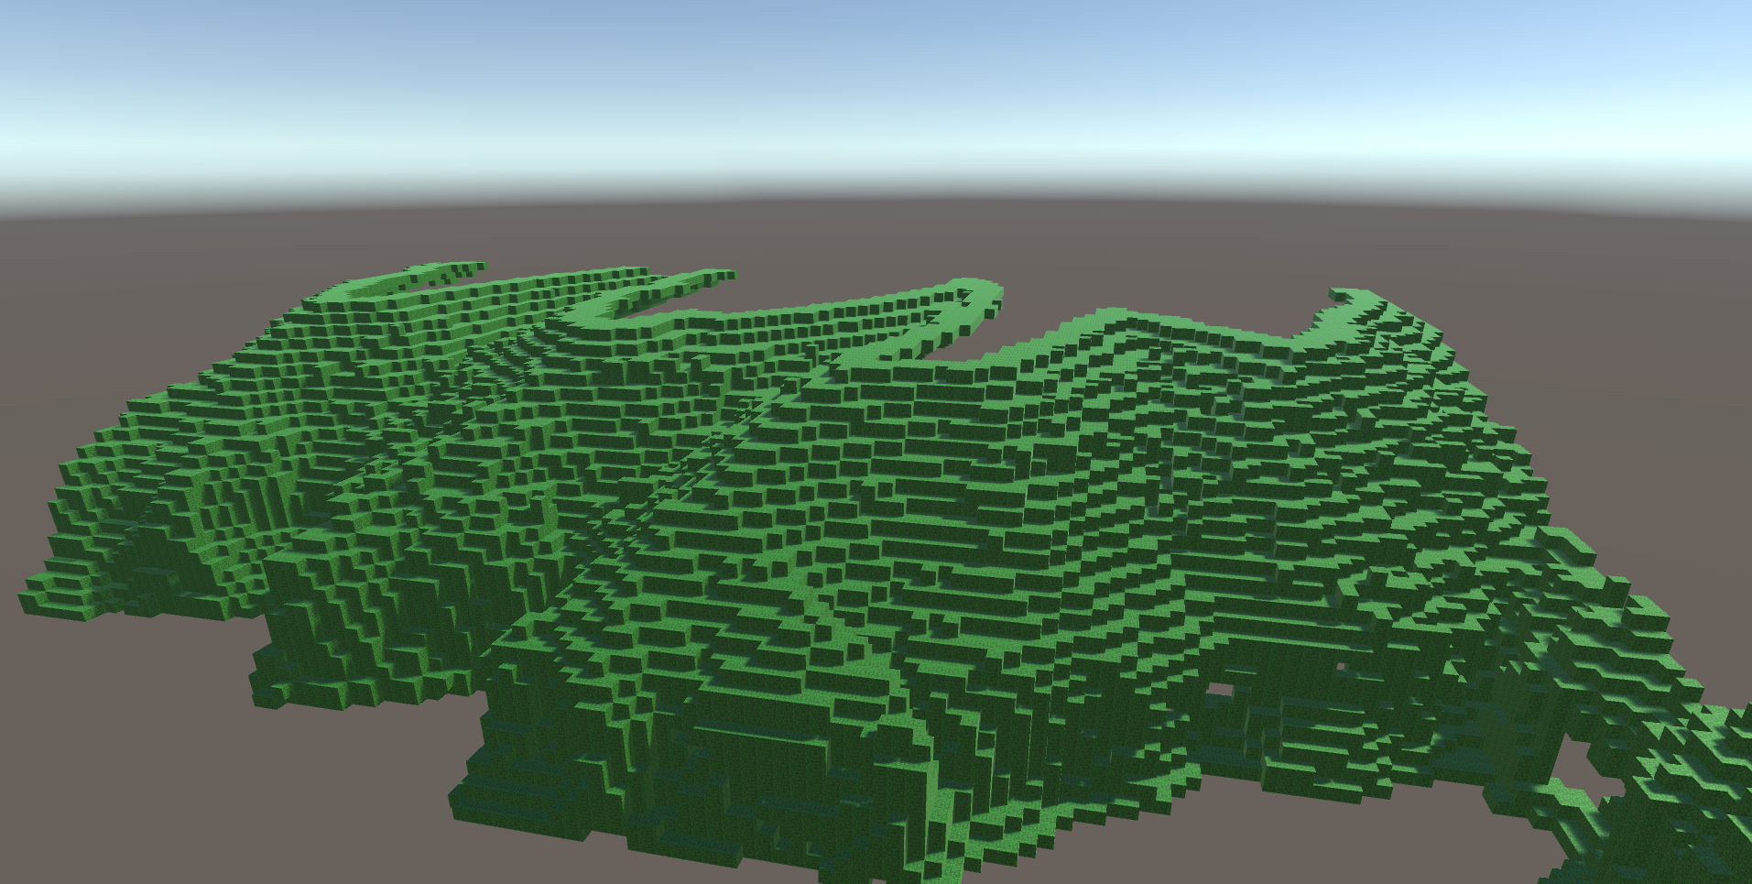
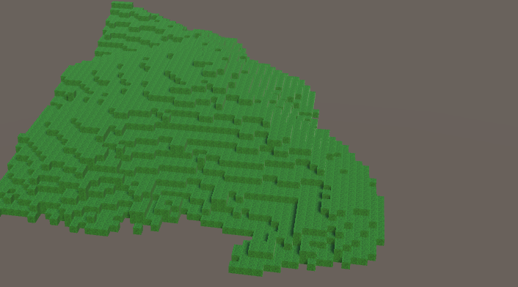
Examples of input training data

Slide 7
What was the most difficult part?
Collecting and extracting the necessary information from extremely large datasets to use for training.
Data collection is expensive and (in our case) manual, while being crucial in order to train the model.

Slide 8
Examples of generated terrains
Terrains that were generated by various iterations of the model that we trained.

Slide 9
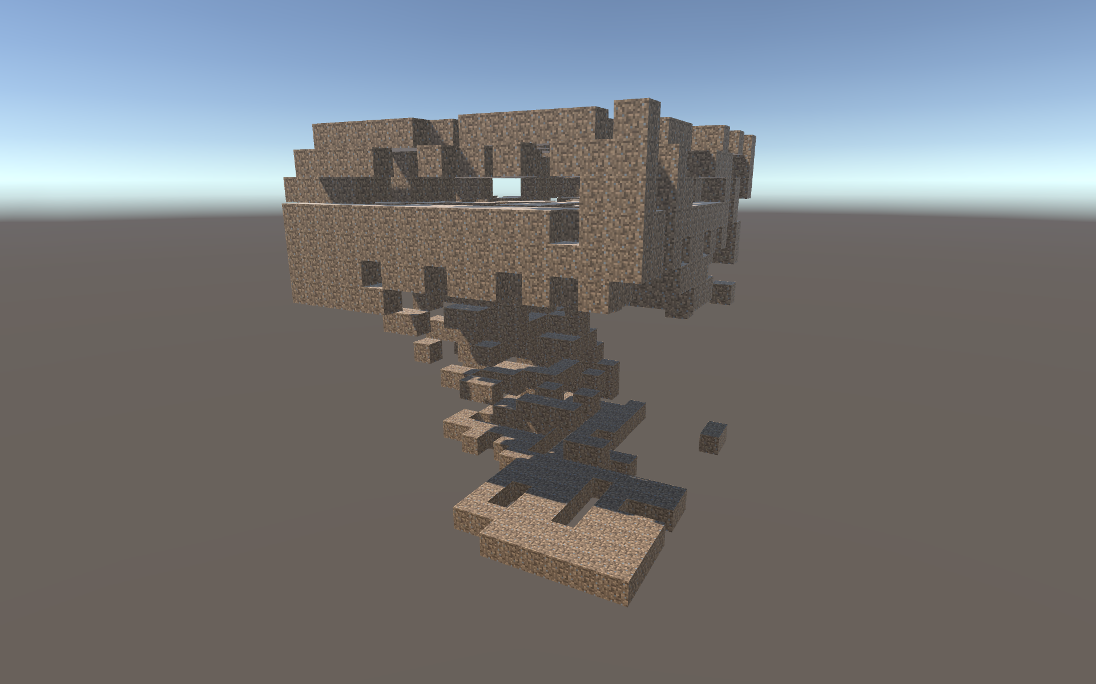
16 x 16 x 16 terrain cube generated by an earlier version of the model.

Slide 10
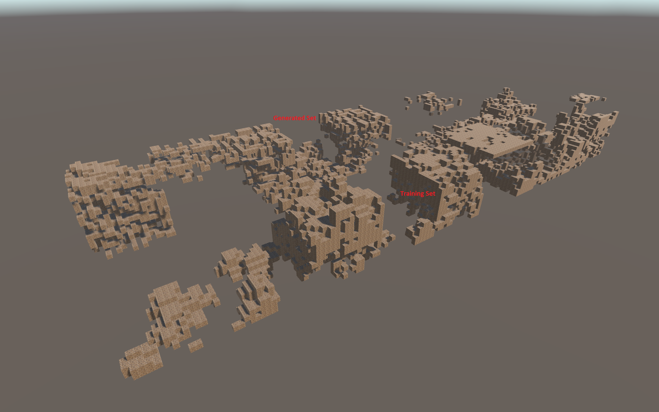
Terrains generated by earlier versions of the model.

Slide 11
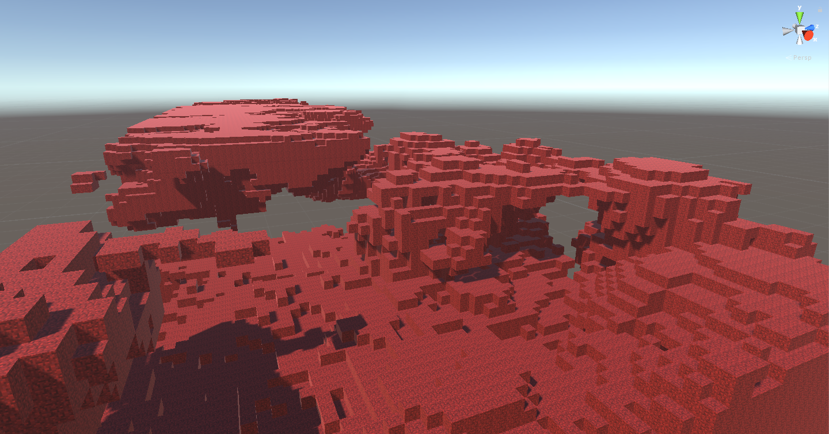
Terrains generated by the final model.

Slide 12
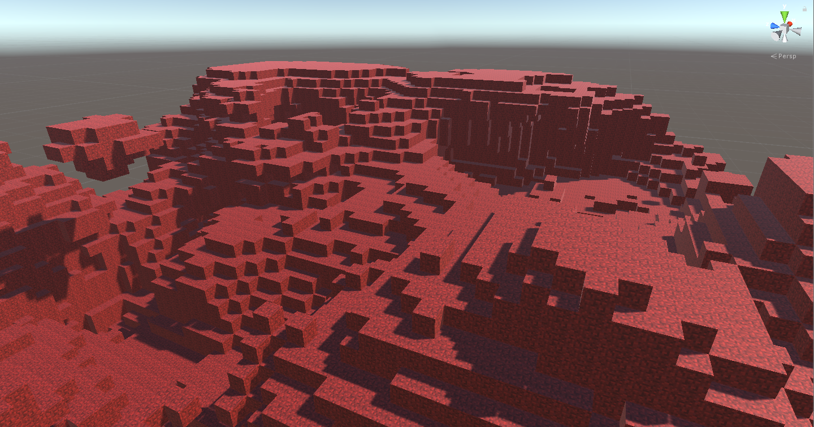
Terrains generated by the final model.

Slide 13
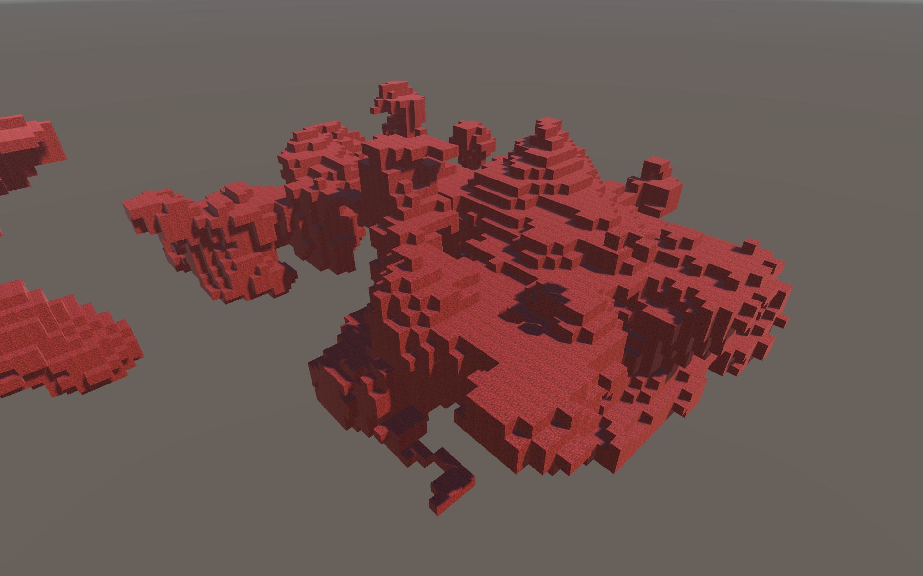
Terrains generated by the final model.

Slide 14
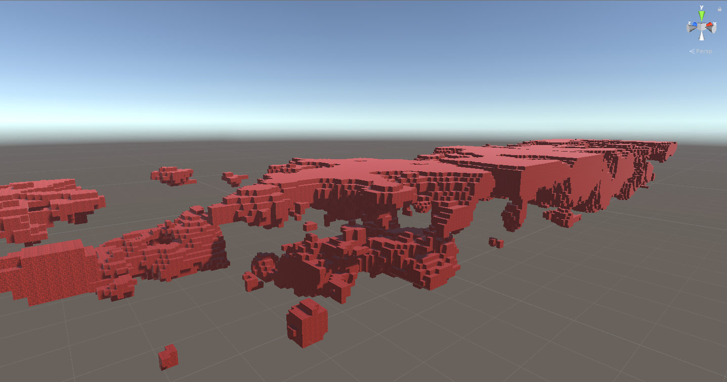
Terrains generated by the final model.

Slide 15
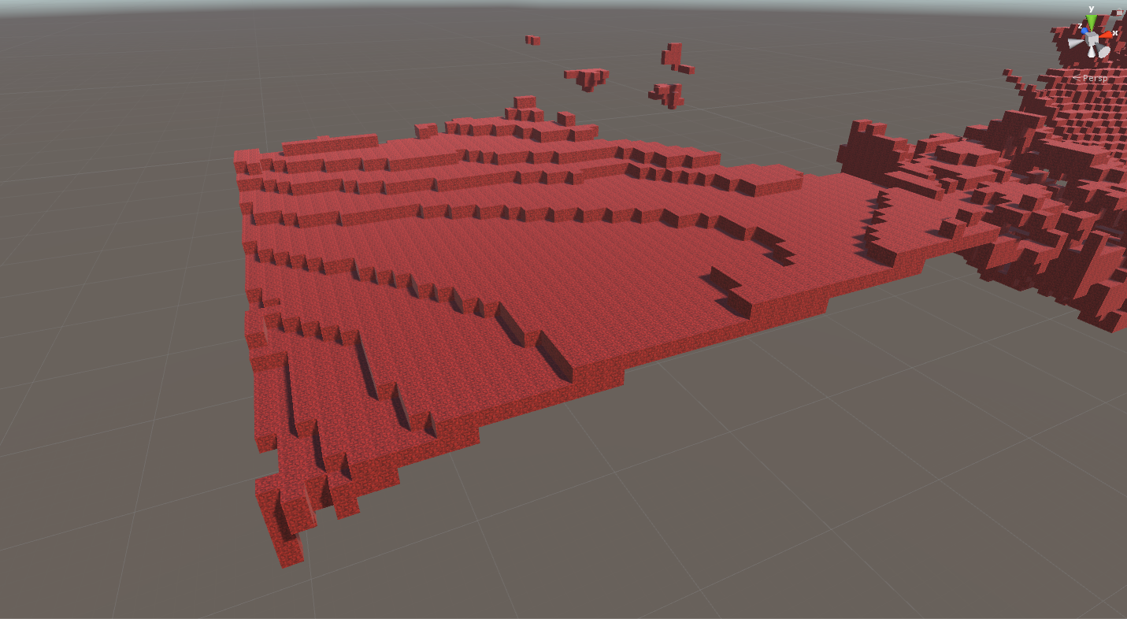
Terrains generated by the final model.

Slide 16
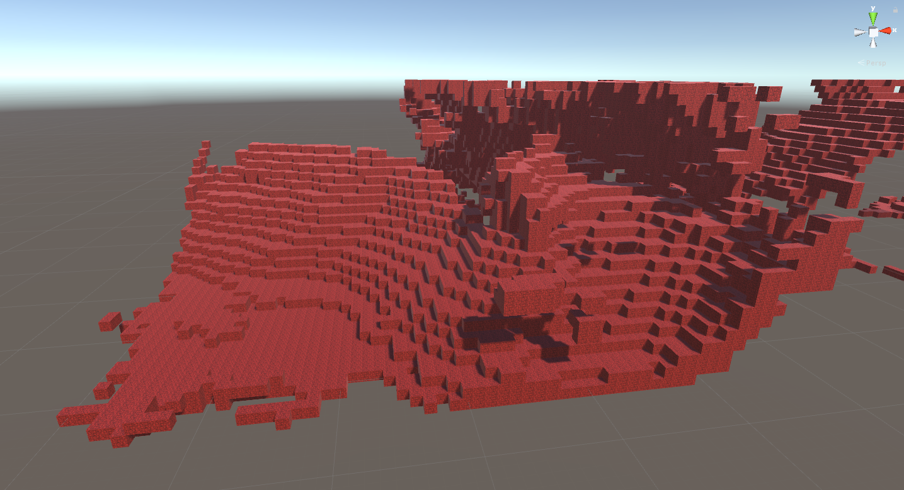
Terrains generated by the final model.

Slide 17
Impact and future development
We’ve proved that significant patterns can be trained with 3-dimensional data

Slide 18
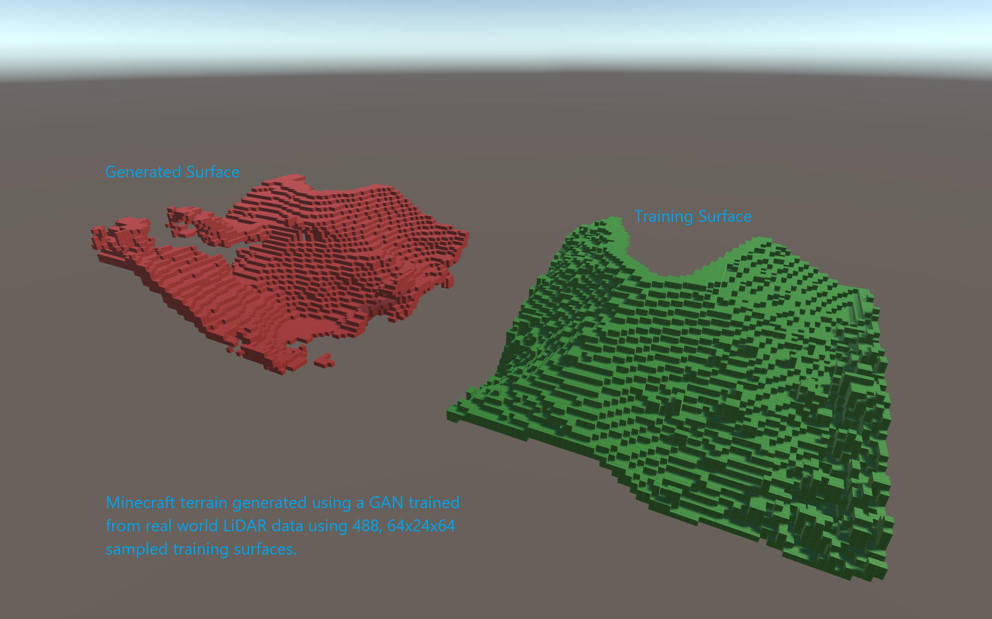

Slide 19
What are the potential benefits to customers and Microsoft?
We can create terrains and 3D models trained from purely volumetric data, which will greatly reduce the time spent to create new worlds, characters, and content.
Customers will be gamers, 3D artists, game studios, and researchers.

Slide 20
What is needed to move the project forward?
Resources. A team to collect and process data at scale. Powerful machines to run training models on deep networks, and developers and researchers to optimize the models and improve accuracy.
Integrating the terrains into the actual Minecraft game, into game engines, and other 3D modeling applications.

Slide 21
What was the most valuable thing we learned?
“I learned that GANs offer a promising new opportunity for gaming and science. The significant progress in our two-day project is proof that there is much more to be explored and experimented.”
- David Parker (Team Leader)

